Slide 1




Amazon ML Challenge Finale PERO_CODERS
Jose
Ramprasad
Pushpraj
Ishan
IIT Madras
IIT Madras
IIT Madras
IIT Madras

Slide 2
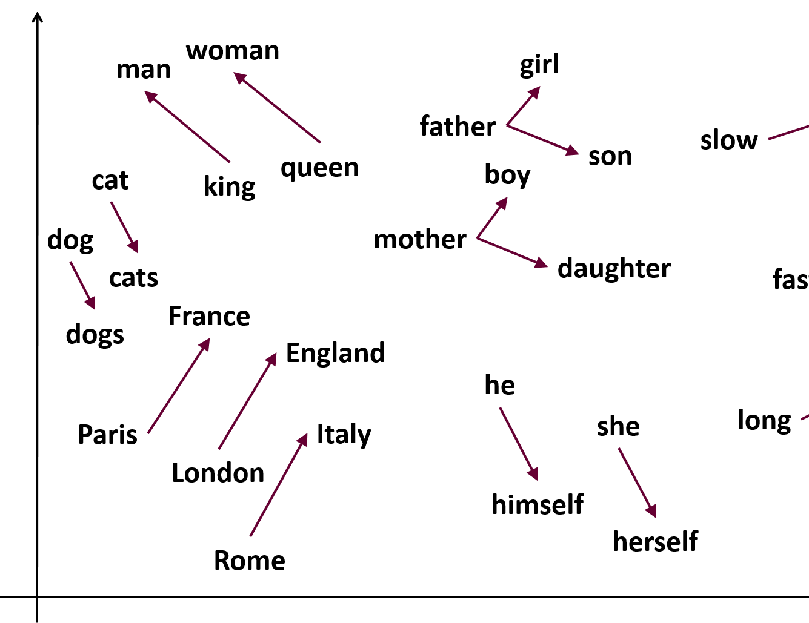

Pre-processing
Pre-processing
The following steps were taken for cleaning data:
The following steps were taken for cleaning data:
①
②
③
④
⑤
*, %, @ → ‘ ‘
The quick brown fox →
a, an, the → →
word2vec vocab
Percentile taken
The
------
quick
------
brown
------
fox
TITLE | DES. | BRAND
99th | 90th | 90th
All characters other than 0-9 and a-z were made to white spaces.
The sentences were then split into words based on white spaces.
Stop words were removed using the nltk library.
The words not present in Google News embedding (size≈3M words) were removed.
We checked the distribution of number of words for each column.
Maximum lengths were 81, 361 and 682. To reduce computational load, we took 99th percentile for ‘TITLE’ , and 90th percentile for ‘Description’ and ‘Bullet Points’ as maximum, giving us upper bounds as 25, 125 and 90 respectively.

Slide 3
Pre-processing (contd.)
The following steps were taken for cleaning data:
⑥
⑦
⑧
→
Number of unique words
The
quick
brown
.
.
.
fox
25
123
241
.
.
.
621
0 0 25 123 241 . . . 621
TITLE | DES. | BRAND
… … 25 … | … … 125 … | … … 90 …
Fixed length
First occurring unique words equal to the upper bound of each column were extracted.
Tokenizer was used on the corpus of 3 columns.
Individual tokenizer fit was performed on columns and they were padded to upper bounds.
These columns were concatenated to 25+125+90 = 240 in length.

Slide 4


Model architecture
Train-validation split
80-20
Number of models used
4
Embedding matrix
gives mapping between tokens and embedding
Flow
Token → word → Google News → Embedding
In model,
Dropout layer
10% dropout rate used
Input layer
Used to take inputs
Embedding layer
Used to give us embedding corresponding to words.
This layer was frozen and not trained.
LSTM layer
Learns order dependence
Fully-connected dense layer
ReLU activation function
Another set of Dropout and Batch Normalization layers
Model | # LSTM layers | Size
1 | 1 | 250
2 | 2 | 200
3 | 2 | 250
4 | 1 | 250
Final layer
Node size = 9919
Softmax = $\frac{\exp\left(x_{i}\right)}{Σ_{j}\exp\left(x_{j}\right)}$
Batch Normalization layer
$$\overline{x}=\frac{\left(x−μ\right)}{(σ+ε)}$$

Slide 5
Training and Submissions
Model Training
Given the huge dataset and limited resources we saved the results after every epoch.
Model weights trained were saved for further training.
The model with a better score was trained further.
Model No | Batch Size | # of epochs | Validation Acc. | Test Acc.
1 | 3500 | 9 | 75.4 | 65.87
2 | 2048 | 6 | 73.8 | 65.73
3 | 1024 | 6 | 75.0 | 65.87
ATTENTION!
Attention helps the LSTM model to better capture starting words and learn more effectively.
And how does it help our model?
We are providing an input of size 240 to the LSTM network which makes it highly likely for LSTM to forget information from the start of the sequence. Attention helps overcome this and trains the model better.
→
Model No | Batch Size | # of epoch. | Validation Acc. | Test Acc.
4 | 1024 | 3 | 76.4 | 66.77
LSTM layer
Attention layer
Dropout layer
Batch normalisation

Slide 6
ENSEMBLING
KEY OBSERVATIONS
①
Selected submission with best accuracy from each model. Total of 4 submissions.
Optimal Length of Padding for the three columns
Addition of attention layer in model 4.
Train for more epochs
②
Used MODE of the values as the mechanism for ensembling.
Final leaderboard score:
69.09
FUTURE SCOPE
More LSTM and attention layers
Train Multiple Models & Ensemble
③
In case of all values being different, value of submission with best accuracy was used as the final value.
Integrate Brand Values in model
That’s all, folks!

